Slide 1

Lending Club Analytics
Yanzhe Li, Nianting Ouyang, Chuanze Cai, Chuanjian Deng

Slide 2
Agenda
Problem Statement
Data Source and Interpretation
Methodology
Results
Conclusion
Future Tasks & Reviews

Slide 3
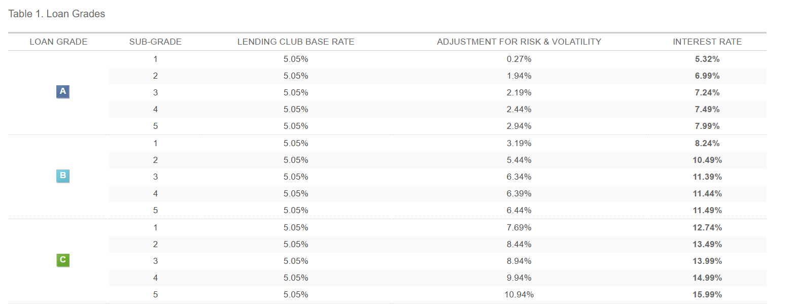
INTRODUCTION
Lending Club determines whether the borrower is creditworthy and assigns to its approved loans a credit grade that determines payable interest rate and fees.

Slide 4
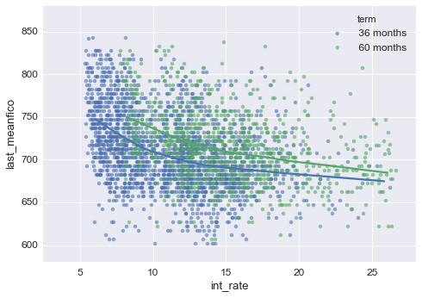
Problem Statement
It is extremely hard to predict a single customer whether he will default or not .
However, it will be much easier for the company to group a customer and calculate the default rate within this particular group.
Therefore, this project aims to improve the grading system and increase the credibility for the company.

Slide 5
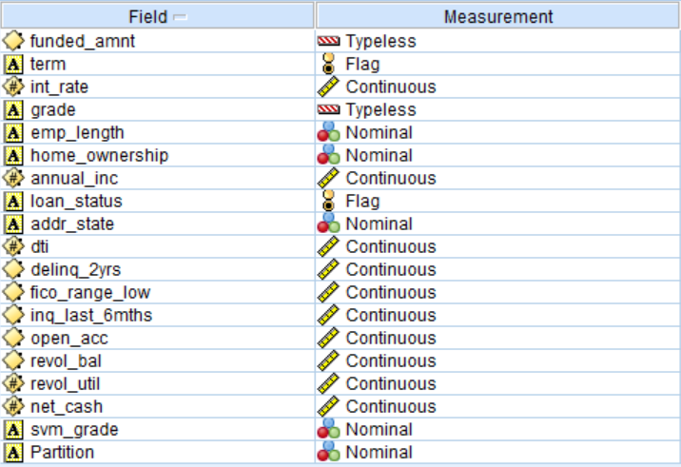
Data Source and Interpretation

Slide 6
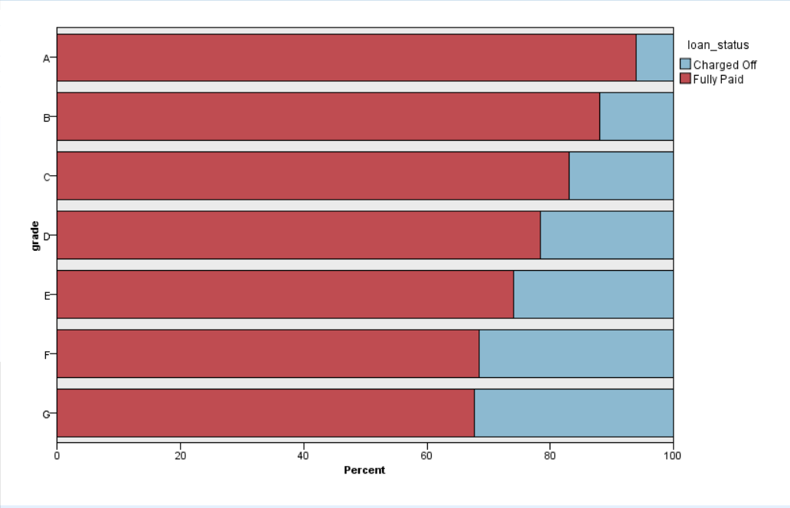
Distribution of current grades

Slide 7
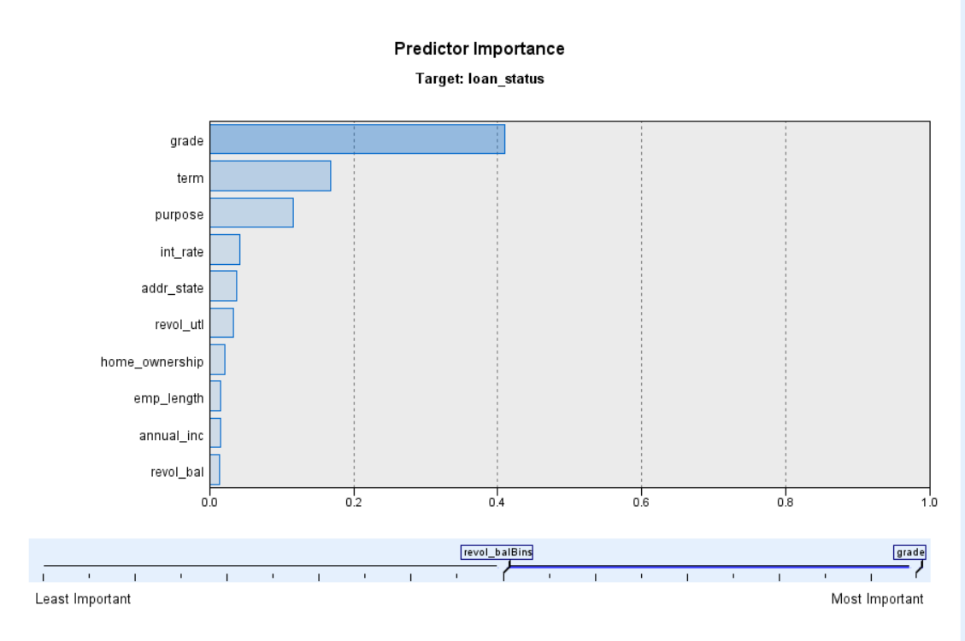
Overall Predictor importance

Slide 8
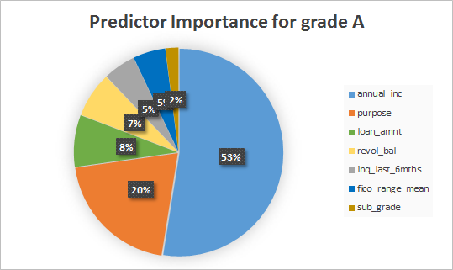
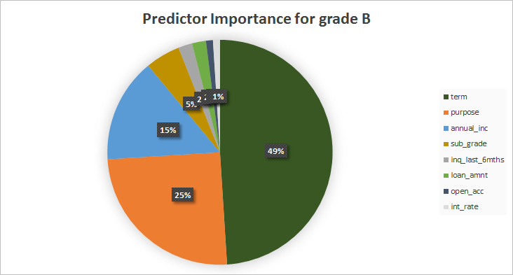
Predictor Importance of grades

Slide 9
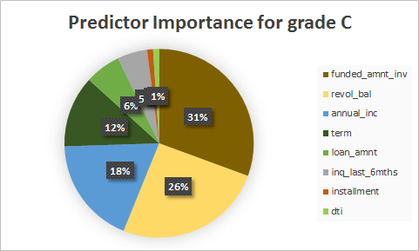
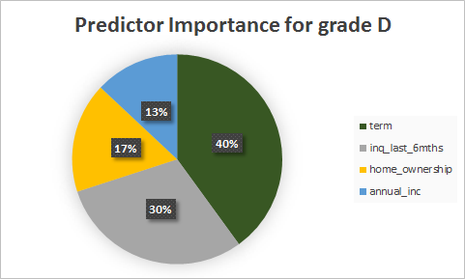
Predictor Importance of grades

Slide 10
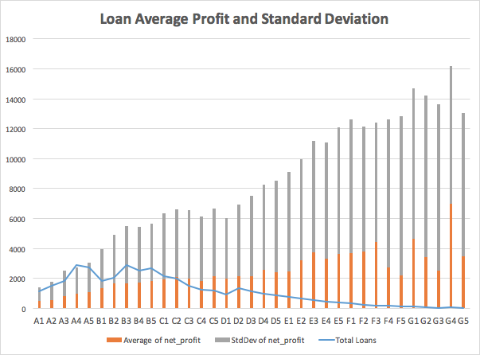
K-fold and svm
1.Most people are high grade from A-C
2.Higher grade leads to lower profit
3.Higher profit leads to higher standard deviation (risk)

Slide 11
Methodology
Data processing
K-Folding
Modified
Sub grading
Criteria
Verification
By
Quantification
Analyzing
Predictor
Importance
Conclusion

Slide 12
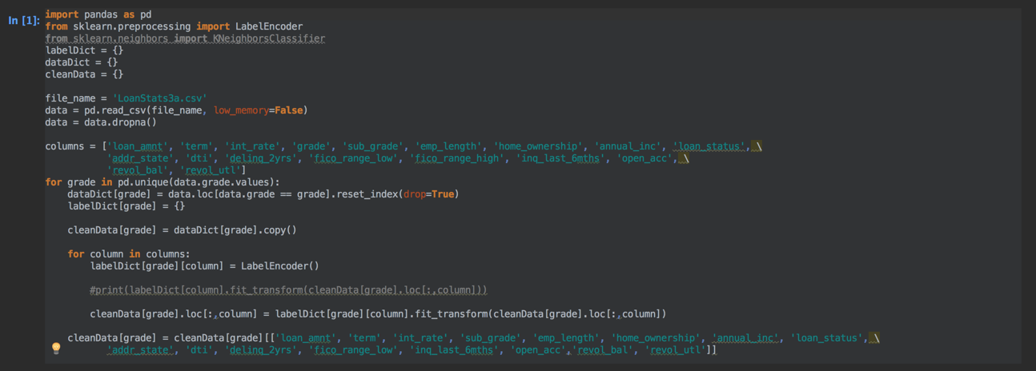
K-Fold and SVM

Slide 13
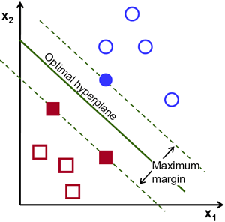
K-fold and SVM
We used 100 k-fold to predict sub grades
Partition a dataset into k-folds
training data: k-1 folds and test the data left -> proceeding until all folds are used as test data
Support Vector Machine
Seek to construct an optimal hyperplane in a high- dimensional space with kernel trick learning tricks

Slide 14
Quantification process
Based on the interest rate for different subgrade, assumptions can be made that profits are conducted when loan status is fully paid and losses are conducted when loan status is charged off.
The loss is determined by portion the not-paid period takes of the whole term.
After calculating the total quantitative result of each grade of grade E,F and G, compare it to the one from raw data to verify if the K-folding worked.

Slide 15
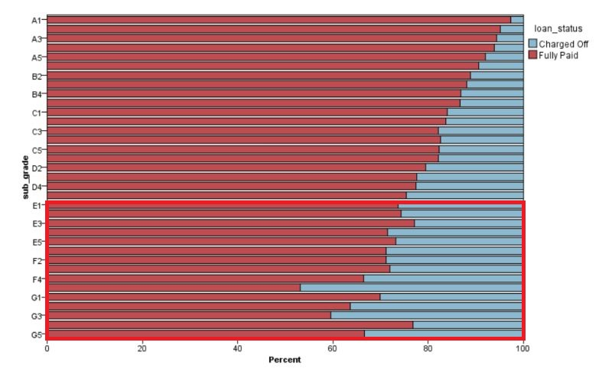
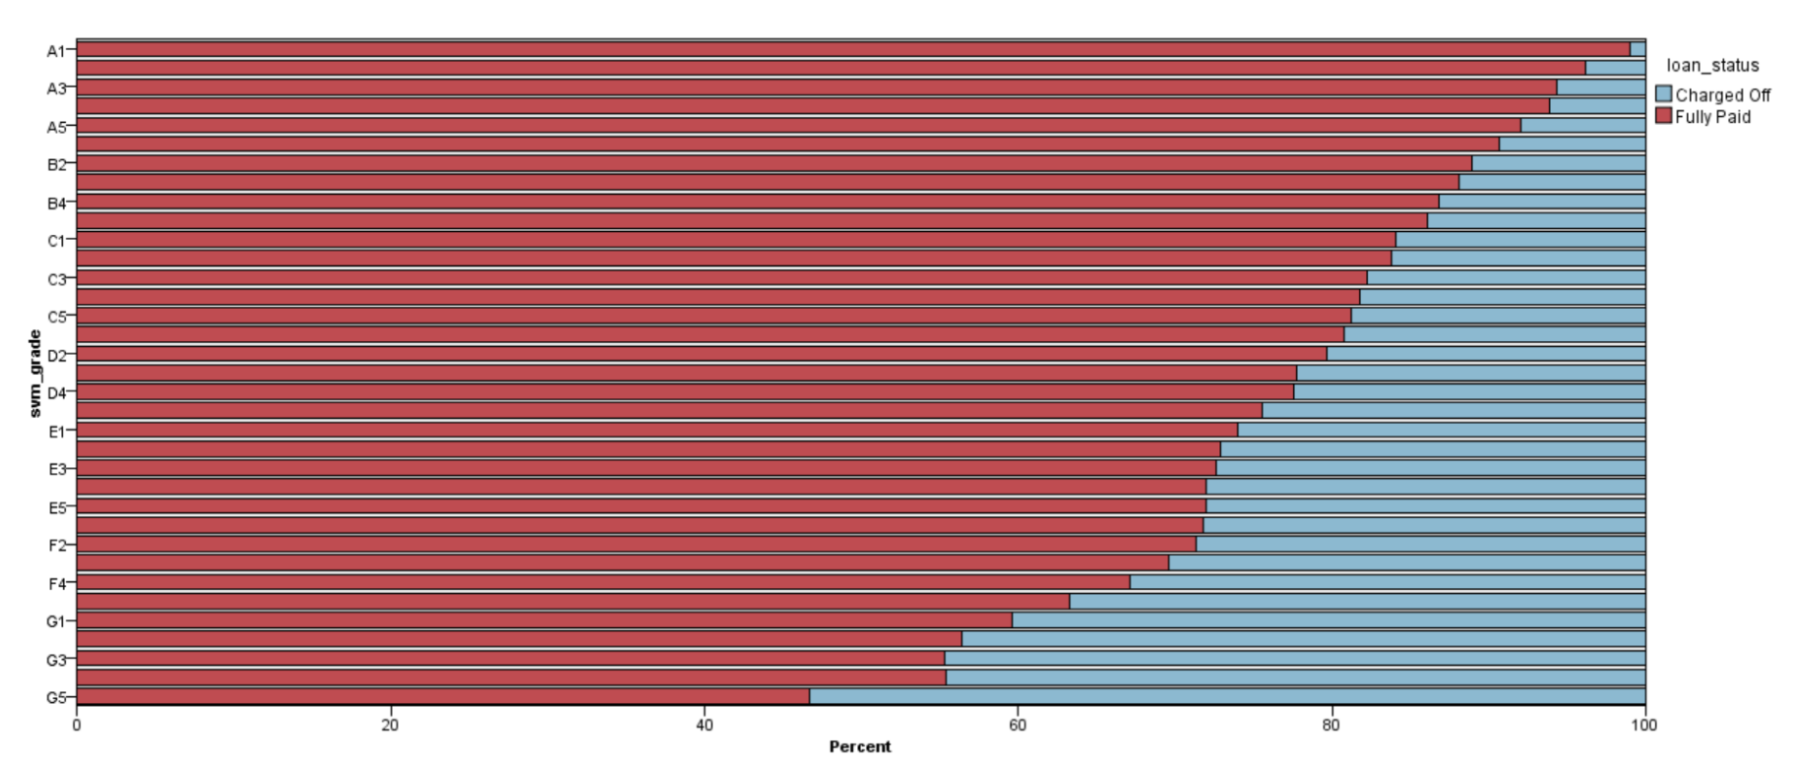
Comparison of the results

Slide 16
Conclusion
The innovation of the project is utilizing K-fold algorithm while determining subgrades, which can relatively increase the accuracy the result and help lending club platform conduct better subgrade results.
The ultimate goal of the result is helping landing club optimizing grading criteria, along with maximizing the profit and minimizing the risk.

Slide 17
FUTURE TASK & REVIEWS
Improvement on model tuning - parameters, optimize the running time
Feature selections - PCA
Machine Learning to increase accuracy - Deep learning with Neural Network
Information collection and selection - more data to process, big data

Slide 18
Thanks & Questions.

